Slide 1
Marketing Lecture # 6 Muhammad asad Instructor department of computer science

Slide 2
Key Learning Point :-
- Discussion about characteristics influencing consumer behavior

Slide 3
BUYER’S CHARACTERISTICS INFLUENCING
BUYER BEHAVIOUR
CULTURAL
FACTORS
Culture
Subculture
Social Class
SOCIAL FACTORS
Reference Groups
&
Social Networks
Family
Roles & status
PERSONAL FACTORS
Age and life-cycle stage
Occupation
Economic situation
Lifestyle
Personality and self-concept
PSYCHOLOGICAL
Motivation
Perception
Learning
Beliefs & attitudes
BUYER

Slide 4
PSYCHOLOGICAL FACTORS
MOTIVATION
When a person is motivated enough, it influences the buying behavior of the person.
A person has many needs at any given time. Some are biological, arising from states of tension such as hunger, thirst, or discomfort. Others are psychological, arising from the need for recognition, esteem, or belonging. (A need becomes a motive when it is inspired to a sufficient level of intensity)

Slide 5
Maslow's hierarchy of needs is a theory by Abraham Maslow, which puts forward that people are motivated by five basic categories of needs --- Physiological, Safety, Love & Belonging, Esteem, And Self-actualization.
In order to better understand what motivates human beings --- Maslow proposed that human needs can be organized into a hierarchy.
This hierarchy ranges from more basic needs such as food and water to self-fulfillment --- According to Maslow, when a lower need is met, the next need on the hierarchy becomes our focus of attention.

Slide 6
PHYSIOLOGICAL NEEDS : Basic physical needs like drinking when thirsty or eating when hungry --- Required to meet the biological requirements for human survival --- Such as air, food, drink, shelter, clothing, sleep (If these needs are not satisfied the human body cannot function optimally).
FOR EXAMPLE
If someone is extremely hungry, it’s hard to focus on anything else besides food. Another example of a physiological need would be the need for adequate sleep.

Slide 7
SAFETY NEEDS : Once an individual’s physiological needs are satisfied, the needs for security and safety arises --- People want to experience order, predictability and control in their lives. These needs can be fulfilled by the family and society (like police, schools, business and medical care).
FOR EXAMPLE
Financial security (we do things like purchase insurance and contribute to a savings account) --- Law and order (freedom from fear) --- Health and wellbeing (safety against accidents and injury).

Slide 8
LOVE AND BELONGING NEEDS : The third level of human needs is social and involves feelings of belongingness --- Includes our need to feel that we belong to a social group.
FOR EXAMPLE
Friendship, closeness, trust, and acceptance --- Receiving and giving affection and love --- Affiliating, being part of a group (family, friends, work).

Slide 9
ESTEEM NEEDS : Maslow classified into two categories --- Esteem for oneself, self-confidence and feeling good about oneself --- Feeling valued by others, our achievements and contributions have been recognized by other people.
SELF-ACTUALIZATION : The desire to accomplish everything that one can --- To become the most that one can be --- One unique feature of self-actualization is that it looks different for everyone --- For one person, self-actualization might involve helping others --- For another person, it might involve achievements in an artistic or creative field.

Slide 10
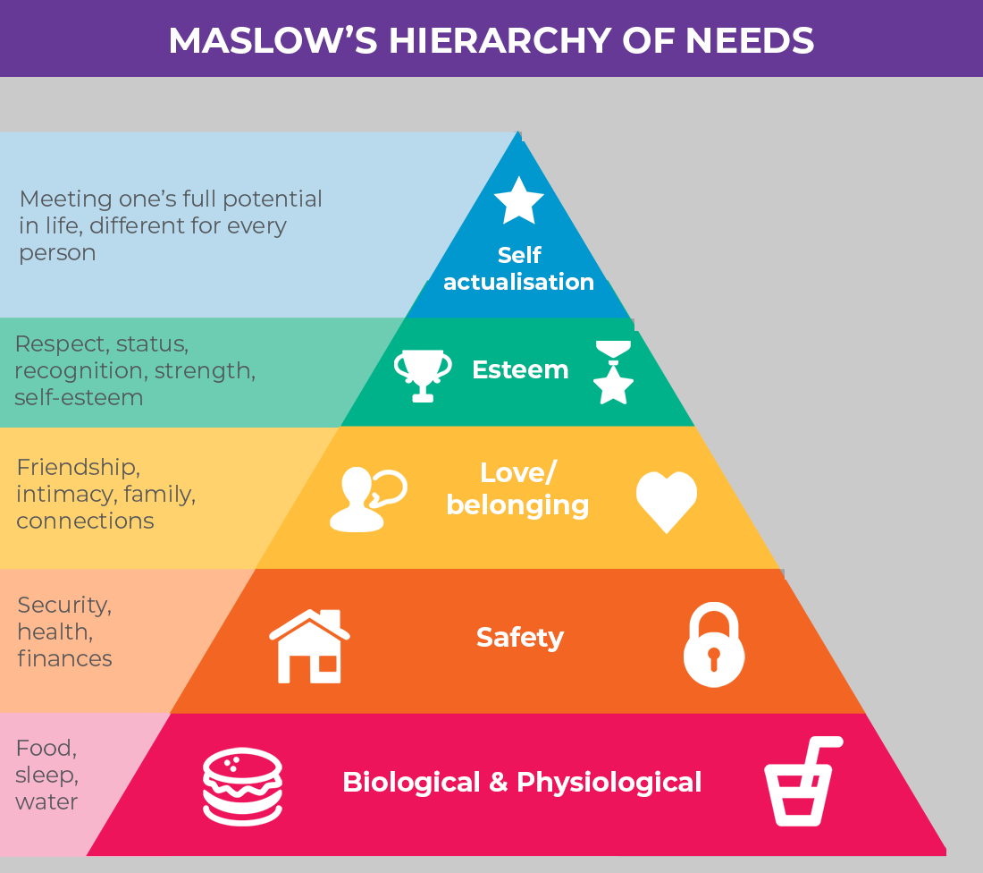

Slide 11
PERCEPTION
Customer perception is a process where a customer collects information about a product and interprets the information to make a meaningful image about a particular product.
When a customer sees advertisements, promotions, customer reviews, social media feedback, and etc. --- Relating to a product, they develop an impression about the product --- Hence consumer perception becomes a great influence on the buying decision of consumers.

Slide 12
FOR EXAMPLE
In 1957, a researcher announced that he had flashed the phrases “Eat popcorn” and “Drink Coca-Cola” on a screen in a New Jersey movie theater every five seconds for 1/300th of a second.
He reported that although viewers did not consciously recognize these messages, they absorbed them subconsciously and bought 58 percent more popcorn and 18 percent more Coke.
Suddenly, advertisers and consumer-protection groups became intensely interested in subliminal perception --- People voiced fears of being brainwashed --- California and Canada declared the practice illegal ---Although the researcher later admitted to making up the data, the issue has not died --- Some consumers still fear that they are being manipulated by subliminal messages.

Slide 13
LEARNING
When a person buys a product, he/she gets to learn something more about the product --- Learning comes over a period of time through experience.
A consumer’s learning depends on skills and knowledge --- While a skill can be gained through practice --- Knowledge can be acquired only through experience.

Slide 14
FOR EXAMPLE
A person motivate him or her to look into buying a camera --- The camera buyer might spot several camera brands in a shop window --- Hear of a special sale price --- or --- Discuss cameras with a friend.
These are all cues that might influence a consumer’s response to his or her interest in buying the product.
Suppose the consumer buys a Nikon camera. If the experience is rewarding, the consumer will probably use the camera more and more, and his or her response will be reinforced.
Then the next time he or she shops for a camera, or for binoculars or some similar product, the probability is greater that he or she will buy a Nikon product.

Slide 15
ATTITUDE AND BELIEFS
A Belief is a descriptive thought that a person holds about something --- Beliefs maybe based on knowledge, opinion, or faith.
Marketers are interested in the beliefs that people formulate about specific products and services --- Because these beliefs make up product and brand images that affect buying behavior --- If some of the beliefs are wrong and prevent purchase --- The marketer will want to launch a campaign to correct them.

Slide 16
An Attitude describes a person’s consistent evaluations, feelings, and tendencies toward an object or idea --- Attitudes put people into a frame of mind of liking or disliking things, of moving toward or away from them.
People have different attitude for religion, politics, clothes, music, and food --- If our camera buyer may hold attitudes such as “Buy the best” --- The Japanese make the best camera products in the world --- So, the Nikon camera would fit well into the consumer’s existing attitudes.

Slide 17

ANY QUESTION
You can contact me at: asadali@uosahiwal.edu.pk
Your query will be answered within one working day.

